Slide 1
Vehicle Detection using Transfer Learning

Slide 2
Problem Statement
The main objective of our project is to detect the various objects present in the video. Additionally we tried to count number of trips the tanker takes in the given CCTV footage from RGUKT video archives.

Slide 3
Abstract
In this day and age CCTV video monitoring has become a tedious task and is very time taking and very error-prone. This project of ours will take on that problem as we try to solve the ever existing problem of CCTV monitoring, mainly vehicle and human detection and frequency assertion.
Our project focuses on the problem at hand “counting vehicle trips around our campus”.

Slide 4
Practical Applications
Face detection
People Counting
Vehicle detection
Manufacturing Industry
Online images
Security

Slide 5
Approaches to the problem statement
Open CV: Open source Computer vision and Machine learning library.
This a very versatile libraray supporterd for many different languages and is used for mainly image processing tasks and in video surveillances.
CNN - A Convolutional Neural Network (ConvNet/CNN) is a Deep Learning algorithm which can take in an input image, assign importance (learnable weights and biases) to various aspects/objects in the image and be able to differentiate one from the other.
R-CNN - Region-CNN (R-CNN) is one of the state-of-the-art CNN-based deep learning object detection approaches. Based on this, there are fast R-CNN and faster R-CNN for faster speed object detection as well as mask R-CNN for object instance segmentation

Slide 6
What’s it about?
Transfer learning is a machine learning method where a model developed for a task is reused as the starting point for a model on a second task.
it is the use of pre-trained models that have been used for another task.
BENEFITS:
it can speed up the time it takes to develop and train a model by reusing these pieces or modules of already developed models. This helps speed up the model training process and accelerate results.
The main advantages are basically that you save training time, that your Neural Network performs better in most cases and that you don’t need a lot of data.

Slide 7
Why is it used?
Don’t have enough data to train Neural Network..
To save a lot of training time, because it can sometimes take days or even weeks to train a deep Neural Network from Scratch on a complete task.
This is very useful since most real-world problems typically do not have millions of labeled data points to train such complex models.

Slide 8
When do we use transfer learning ?
You would typically use Transfer Learning when
Don’t have enough labeled training data to train your network from scratch and/or
There already exists a network that is pre-trained on a similar task, which is usually trained on massive amounts of data.

Slide 9
Object Detectors
R-CNN and their variants, including the original R-CNN, Fast R- CNN, and Faster R-CNN
Single Shot Detector (SSDs)
YOLO

Slide 10
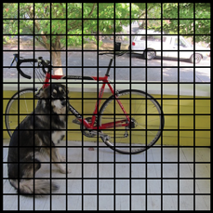
YOLO

Slide 11
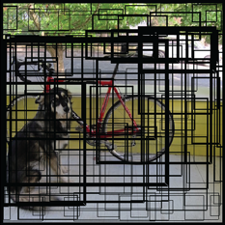
YOLO-contd.

Slide 12
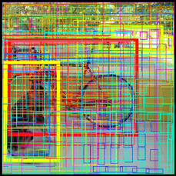
YOLO-Contd.
Since there are 13×13 = 169 grid cells
and each cell predicts 5 bounding boxes,
we end up with 845 bounding boxes in total

Slide 13
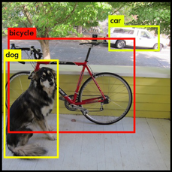
YOLO-Contd

Slide 14
Work Done Till now
Detection and count using openCV (Internship) -- demo
Using transfer learning for detection using pre-trained YOLO-COCO model
Count increment when the centroid crosses the preferred ROI
Using the Tensorflow object counting API to count the trips from the video.

Slide 15
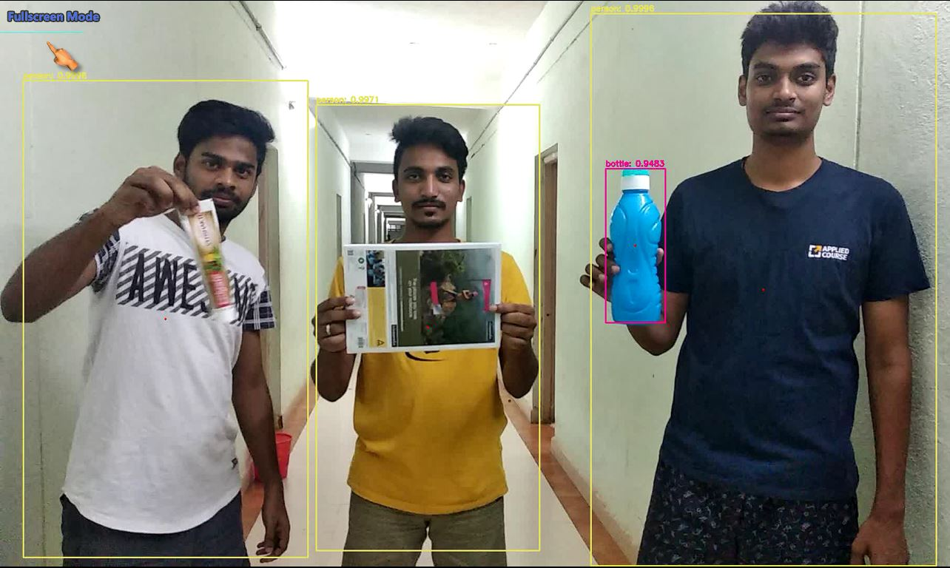
Output

Slide 16
DEMO

Slide 17
Made By:
S. Mohneesh
P. Surya Deepak
M. Lokesh

Slide 18
Thank you

